Slide 1
coding and calling methods

Slide 2
Syntax -method
To start, you code an access modifier that indicates whether the method can be called from other classes.
In most cases, you'll use the private access modifier so the method can only be called from within the class where it's coded.
If you need to call the method from another class, however, you can use the public access modifier

Slide 3
How to code methods
After the access modifier, you code the return type for the method, which identifies the type of data that the method returns.
Then, within the method, you must code a return statement that identifies the value to be returned. This value must correspond to the data type that's specified as the return type.
If the method doesn't return any data, you code the void keyword as the return type. Then, you don't code a return statement.

Slide 4
How to code methods
After the return type, you code the name of the method. In most cases, you'll give the method a name that indicates the action it performs.
A common coding convention is to start each method name with a verb. Example : DisableButtons, GetDiscountPercent, and CalculateFutureValue.
After the method name, you code a set of parentheses. Within the parentheses, you declare the parameters that are required by the method. This is known as the parameter list

Slide 7
How to call methods
To start, you can type the optional this keyword to specify that the method that's being called is in the current class, followed by the dot operator and the method name.
Otherwise, you just code the method name and the current class is assumed.

Slide 8
How to call methods

Slide 9
How to call methods

Slide 10
How to call methods
When you call a method, you typically code the arguments in the same sequence that's used by the parameter list in the method. This is called passing arguments by position.
When you call a method that returns a value, you can assign that value to a variable.
You can also code a method call within an expression.
For example, you could use the GetDiscountPercent method in an expression like this:
total = subtotal * (1 - this.GetDiscountPercent(subtotal))

Slide 11
Optional parameters
When you code a method, you may occasionally want to provide default values for one or more parameters in case the user doesn't provide values for them.
To do that, you can use a feature of C# called optional parameters.
Notes:
11

Slide 12
Optional Parameters
For instance there is a method called AddNumber(int firstNumber, int secondNumber) which takes two parameters and returns sum of two parameters.
In general way, it is mandatory to pass two parameter values when we call the method.
However Optional Parameter helps here and we can pass only one/two parameters to the method.

Slide 13
Optional Parameters
To declare an optional parameter, you assign a default value to the parameter. Then, if a value isn't passed to this parameter, the default value is used.
In the following code, secondNumber default value is “0”. So we can pass only one parameter to the method and complier will assume second parameter value “0” and return result as “12”.

Slide 14
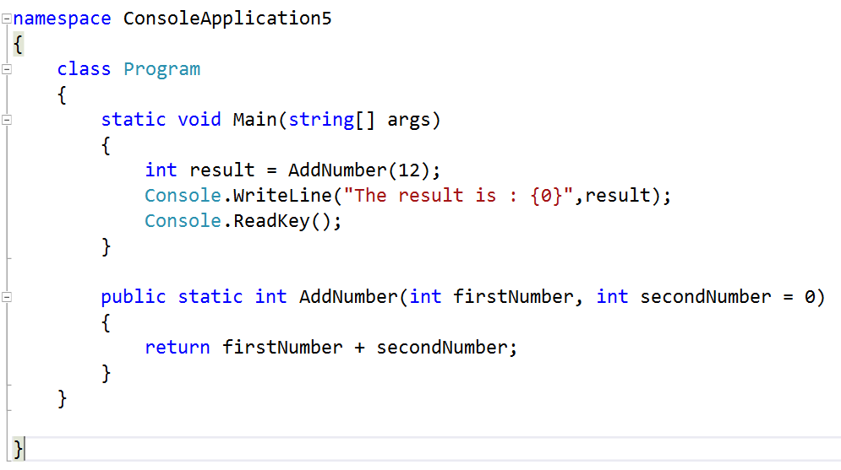

Slide 15

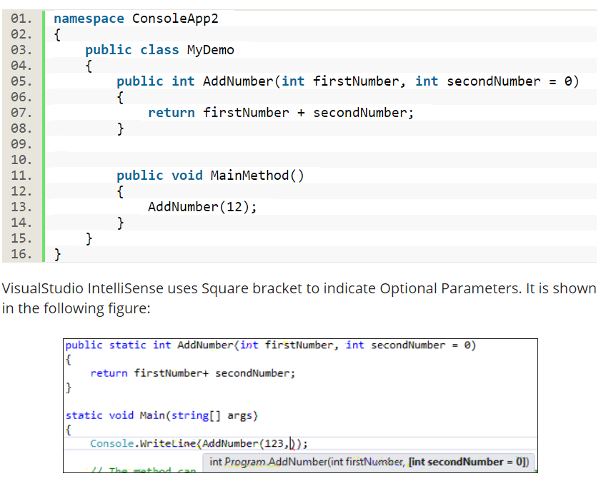
Notes:
namespace ConsoleApplication5
{
class Program
{
static void Main(string[] args)
{
int result = AddNumber(12);
Console.WriteLine("The result is : {0}",result);
Console.ReadKey();
}
public static int AddNumber(int firstNumber, int secondNumber = 0)
{
return firstNumber + secondNumber;
}
}
}

Slide 16
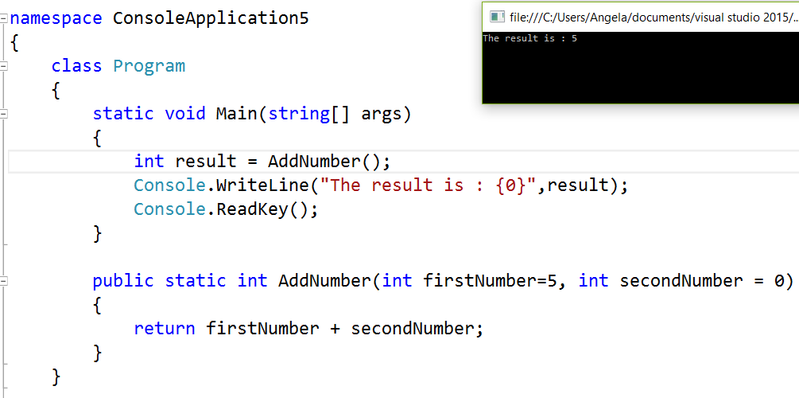

Slide 17
How to use optional parameters
When you use optional parameters, you should realize that they must be coded after all required parameters.
In addition, you can't omit an argument for one optional parameter and then pass an argument for another optional parameter that appears later in the parameter list. You can't do that if you pass the arguments by position.
However, you can omit an argument for any optional parameter if you pass the arguments by name.

Slide 18
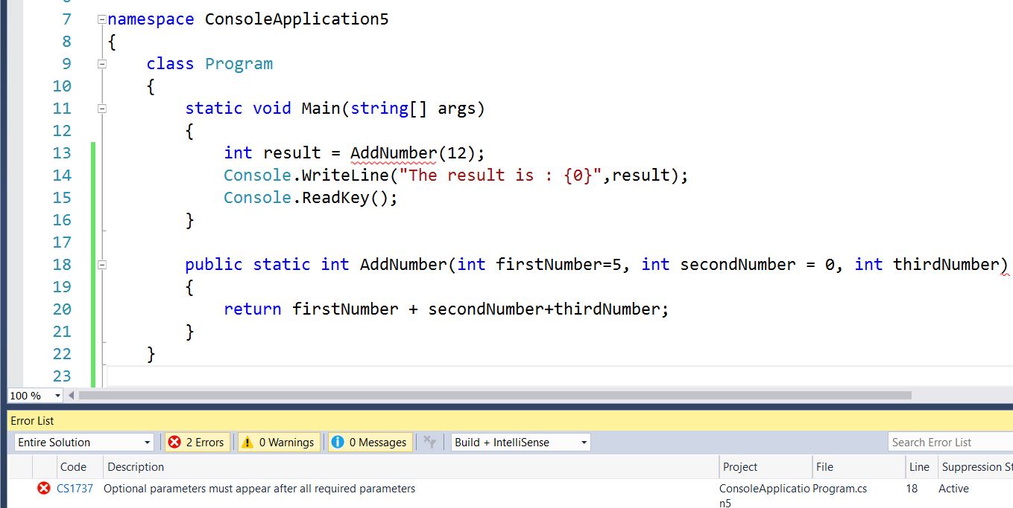

Slide 19
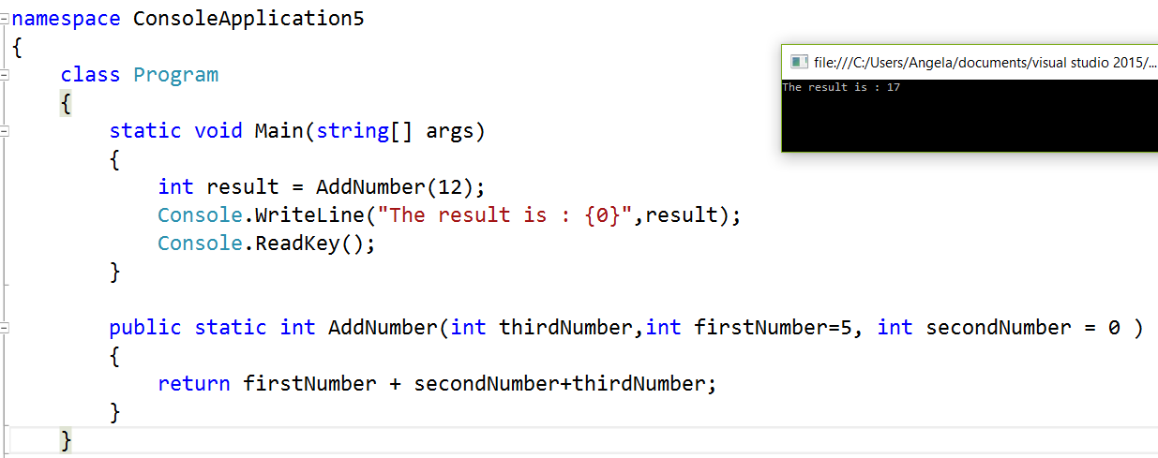

Slide 20
How to pass arguments by name
To pass arguments by name, you code the name of the parameter followed by a colon and the name of the argument.
Generally we maintain parameters sequence when we pass parameters to a method. However in Named Parameter, it doesn’t need to maintain sequence while passing parameters to a method rather we can pass parameters with parameter name.
Secondly, Parameter name should match with method definition parameter name.

Slide 21
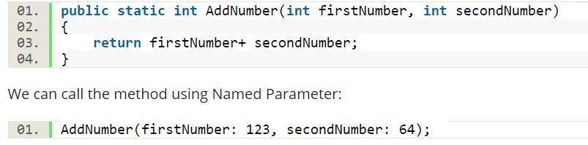
Here firstNumber and secondNumber are two parameters we are passing to AddNumber() method using Named Parameter. If it doesn’t match the method definition parameter name and Named Parameter Name then it throws compilation error “The best overload for 'AddNumber' does not have a parameter named 'secondNumber1'”

Slide 22
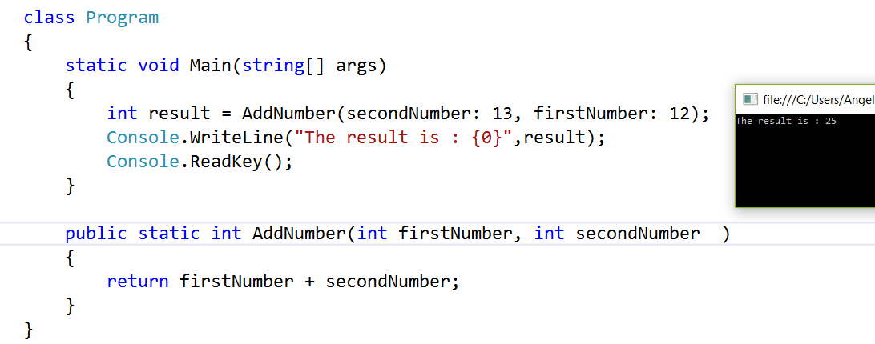
It is not mandatory to maintain parameter sequence as we are using named parameter concept.

Slide 23
Passing arguments by reference and by value
By default, the arguments that are passed to a method are passed by value.
That means that the value of each passed variable is assigned to the corresponding parameter in the method.
Because of that, the method can change the value of the parameter without affecting the value of the variable in the calling method

Slide 24
Pass arguments by reference
In some cases, though, you'll want to be able to change the value of the variable in the calling method from the called method.
To do that, you can pass the argument by reference using the ref or out keyword as shown in the next slide.
An argument passed using the ref keyword must be defined in the calling method before getting passed to the called method.

Slide 25
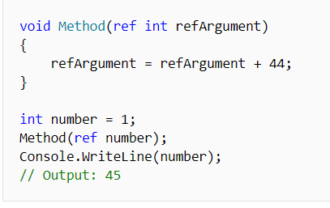
ref parameter
To use a ref parameter, both the method definition and the calling method must explicitly use the ref keyword, as shown in the following example.

Slide 26
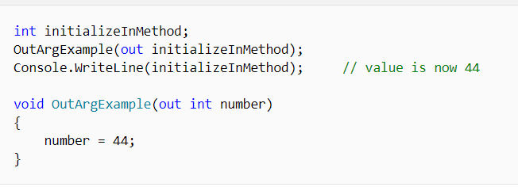
out keyword
The out keyword causes arguments to be passed by reference.
It is like the ref keyword, except that ref requires that the variable be initialized before it is passed.
To use an out parameter, both the method definition and the calling method must explicitly use the out keyword.
Variables passed as out arguments do not have to be initialized before being passed in a method call. However, the called method is required to assign a value before the method returns.

Slide 27
Declaring out arguments
Declaring a method with out arguments is useful when you want a method to return multiple values.
The following example uses out to return three variables with a single method call.
Note that the third argument is assigned to null.

Slide 28
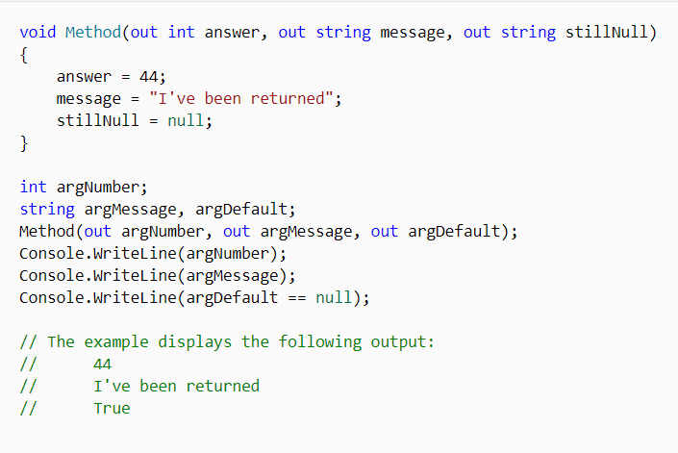

Slide 29
Which is better – Pass by Value/Reference & out/ref
In general, it's better to pass arguments by value instead of by reference. That way, the data in the calling method can't be changed by the called method.
In addition, it's a good coding practice to always initialize variables, in which case you can use the ref keyword instead of the out keyword.

Slide 30
How to use refactoring to create a new method and its calling statement
To refactor the code, you just select the code you want to create a method from, right -click on the selected code, choose the Extract Method command from the Refactor submenu, and enter a name for the new method.

Slide 31
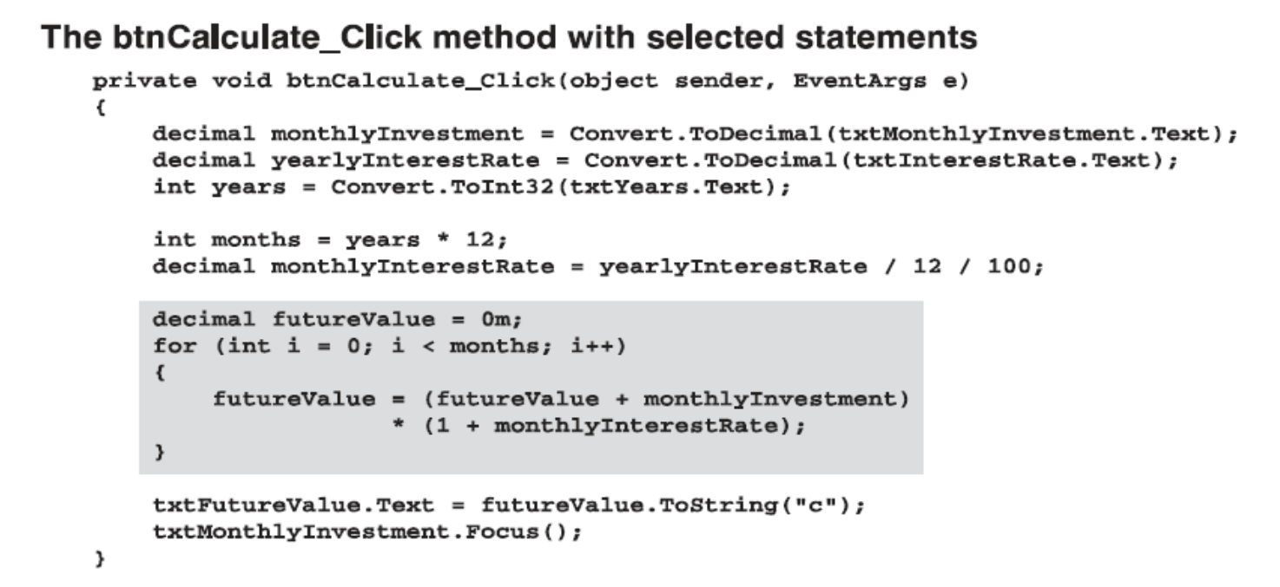

Slide 32
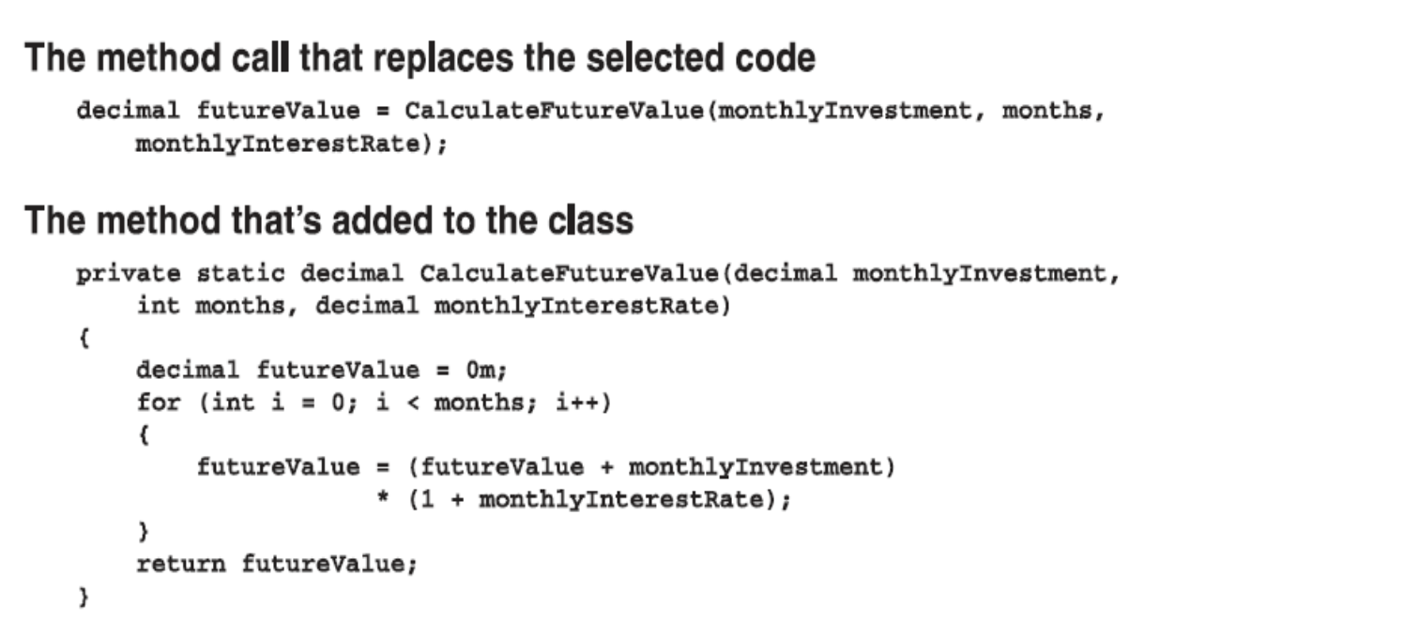

Slide 33
How to use refactoring to create a new method and its calling statement
In this figure, you can see that refactoring creates both a call statement and a new method named CalculateFutureValue.
The only significant difference between this method and the CalculateFutureValue method in slide 12, is that the refactored method includes the static keyword.

